Slide 1

Platform Override Mechanism
Insyde Software March 2021

Slide 2
Copyright 2021 Insyde Software Corp., All Rights Reserved.
No part of this publication may be reproduced, transmitted, transcribed, stored in a retrieval system, or translated into any language or computer language, in any form, or by any means, electronic, mechanical, magnetic, optical, chemical, manual or otherwise, without the prior written permission of Insyde Software Corp.
Disclaimer
Insyde Software Corp. (“Insyde”), provides this document and the programs "as is" without warranty of any kind, either expressed or implied, including, but not limited to, the implied warranties of merchantability or fitness for a particular purpose.
This document may contain technical inaccuracies or typographical errors. Changes are periodically made to the information herein; these changes will be incorporated in future revisions of this document. Insyde is under no obligation to notify any person of the changes. Some code names featured in this document are used to identify products that are in development and not yet publicly announced for release. Insyde is not obligated for its accuracy or completeness.
This document may contain third party’s information, features, schedules, code names, and product names, which are based on Insyde’s interpretation available as of the creation of this document and may be changed from time to time. Neither Insyde nor the third party is obligated to notify such change. If you are interested in third party’s information, you may contact the local third party sales office or the local distributor to obtain the latest specifications. All the intellectual property right of any third party information remains to its owner or steward.

Slide 3
Agenda
Goals & Target Audience
Basic Concept of Override
How to Use Override
Override Report
Internal Use

Slide 4
Goal & Target Audience

Slide 5
Goal & Target Audience
Target Audience:
BIOS developers who use InsydeH2O 5.x (EDK II) to create their firmware products.
Goals:
Understand the concept of Override mechanism.
Be familiar with using the Override mechanism for project porting.
Requirements:
InsydeH2O 5.4 source code

Slide 6
Basic Concept of Override

Slide 7
Basic Concept of Override
1st Layer
A
B
C
D
E
F

Slide 8
Basic Concept of Override
1st Layer
2nd Layer
A
B
C
A
D
E
F
E

Slide 9
Basic Concept of Override
1st Layer
2nd Layer
A
B
C
A
A
D
E
F
E
E

Slide 10
Basic Concept of Override
1st Layer
2nd Layer
A
B
C
A
A
D
E
F
E
E

Slide 11
Basic Concept of Override
1st Layer
A
B
C
C
D
E
F
3rd Layer
F
2nd Layer
A
A
E

Slide 12
Basic Concept of Override
1st Layer
A
B
C
C
D
E
F
3rd Layer
F
A
C
A
C
2nd Layer
F
F
A
A
E

Slide 13
Basic Concept of Override
1st Layer
A
B
C
D
E
F
3rd Layer
A
C
2nd Layer
F
A
E

Slide 14
Basic Concept of Override
1st Layer
Combo
A
B
C
A
A
C
D
E
F
3rd Layer
E
F
A
C
2nd Layer
F
A
E

Slide 15
Basic Concept of Override
Avoid editing in place and make updating easier
Minimize the number of files modified
The minimum size of an override is a single file
Only files that are modified should appear in the overriding folder
Duplicate directory structure
The overriding sub-tree must have exactly the same structure as the overridden sub-tree

Slide 16
How to Use Override

Slide 17
How to Use Override
Where:
Project.dsc
How:
!disable
<SOURCE_OVERRIDE_PATH>
!disable InsydeModulePkg/Bus/Isa/Ps2KeyboardDxe/Ps2keyboardDxe.inf
InsydeModulePkg/Bus/Isa/Ps2KeyboardDxe/Ps2keyboardDxe.inf {
<SOURCE_OVERRIDE_PATH>
$(PROJECT_PKG)/Override/Insyde/InsydeModulePkg/Bus/Isa/Ps2KeyboardDxe
}
Use of SOURCE_OVERRIDE_PATH is not recommended !!

Slide 18
How to Use Override
Support more than one override path:
InsydeFrameworkModulePkg/Compatibility/Library/SetupDefaultLib/SetupDefaultLib.inf {
<SOURCE_OVERRIDE_PATH>
$(PLATFORM_CRB)/$(DEMOBOARD_FAMILY)/$(DEMOBOARD_NAME)/Dxe/UefiSetupUtility
$(PLATFORM_CRB)/$(PROJECT_FAMILY)/$(PROJECT_NAME)/Dxe/UefiSetupUtility
$(PLATFORM_CRB)/Override/$(PLATFORM_CRB)/$(DEMOBOARD_FAMILY)/$(DEMOBOARD_NAME)/Dxe/UefiSetupUtility
$(PROJECT_PKG)/Override/$(PLATFORM_CRB)/$(DEMOBOARD_FAMILY)/$(DEMOBOARD_NAME)/Dxe/UefiSetupUtility
}

Slide 19
How to Use Override Override in Project.dsc
Syntax
Example
!disable Original_Path/Module.inf
!disable MdeModulePkg/Universal/StatusCodeHandler/Smm/StatusCodeHandlerSmm.inf
Original_Path/Module.inf {
MdeModulePkg/Universal/StatusCodeHandler/Smm/StatusCodeHandlerSmm.inf {
<SOURCE_OVERRIDE_PATH>
<SOURCE_OVERRIDE_PATH>
Override_Path}
$(PROJECT_PKG)/Override/EDK2/MdeModulePkg/Universal/StatusCodeHandler/Smm }

Slide 20
How to Use Override Example
Duplicate directory structure
Ex: EDK2\MdeModulePkg\Core\Dxe\Event
MdeModulePkg/Core/Dxe/DxeMain.inf {
<SOURCE_OVERRIDE_PATH>
MdeModulePkg/Override/Core/Dxe
}

Slide 21
How to Use Override Example
Override the INF file only when it needs to change
Ex: Add GUID/Library Class/PPI/Protocol/PCD/Package/Depex/…
!disable InsydeModulePkg/Universal/FirmwareVolume/FwBlockServiceSmm/FwBlockServiceSmm.inf
InsydeModulePkg/Universal/FirmwareVolume/FwBlockServiceSmm/FwBlockServiceSmm.inf {
<SOURCE_OVERRIDE_PATH>
$(PROJECT_PKG)/Override/Insyde/InsydeModulePkg/Universal/FirmwareVolume/FwBlockServiceSmm
}

Slide 22
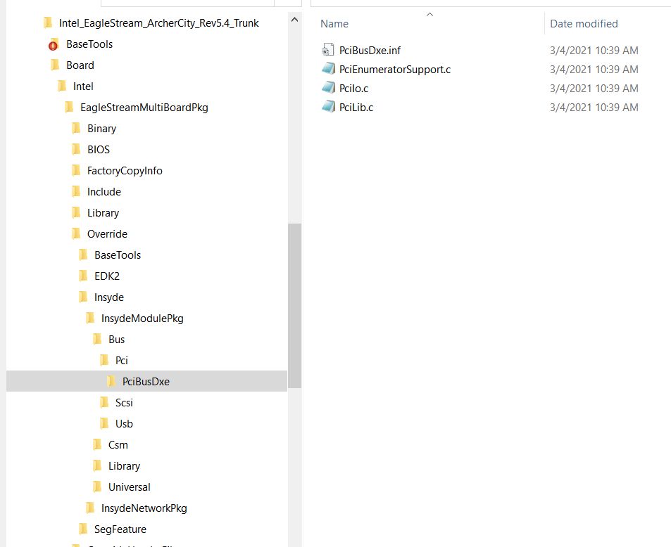
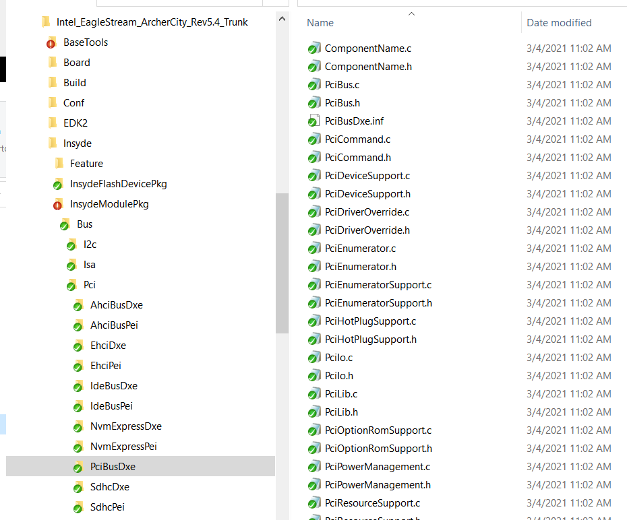
How to Use Override Example
OVERRIDE
ORI

Slide 23
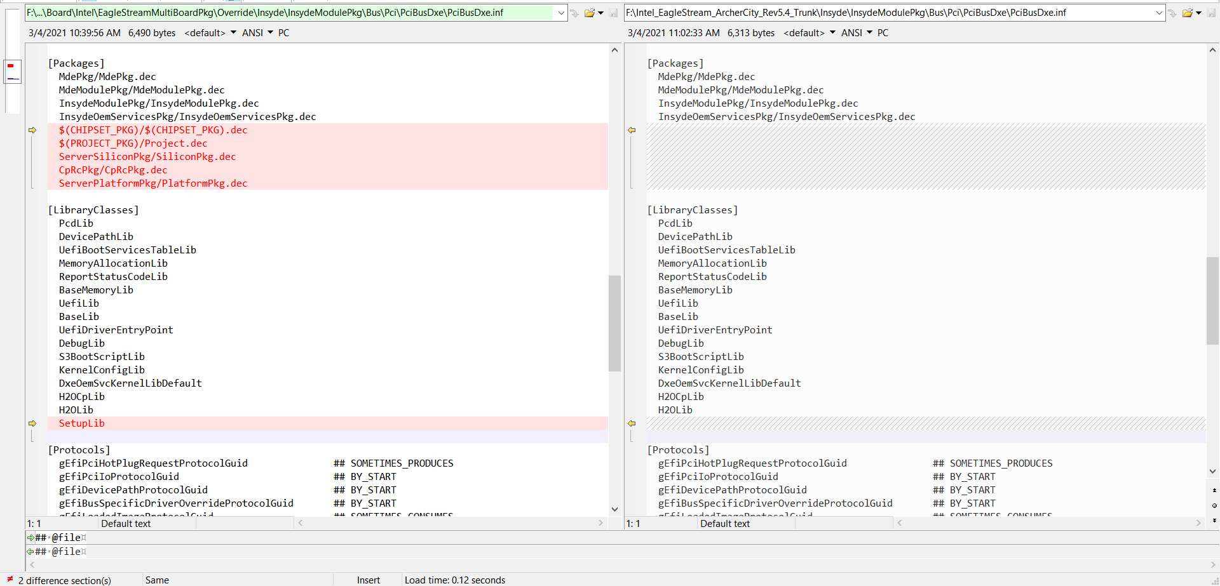
How to Use Override Example
OVERRIDE
ORI

Slide 24
Override Report

Slide 25
Override Report Override.txt
Location:
$(WORKSPACE)/Build/$(PROJECT_PKG)/Override.txt
Format:
Path\Module.inf
Original Path\Original Source File Override Path/Override Source File

Slide 26
Thanks!

